Slide 1
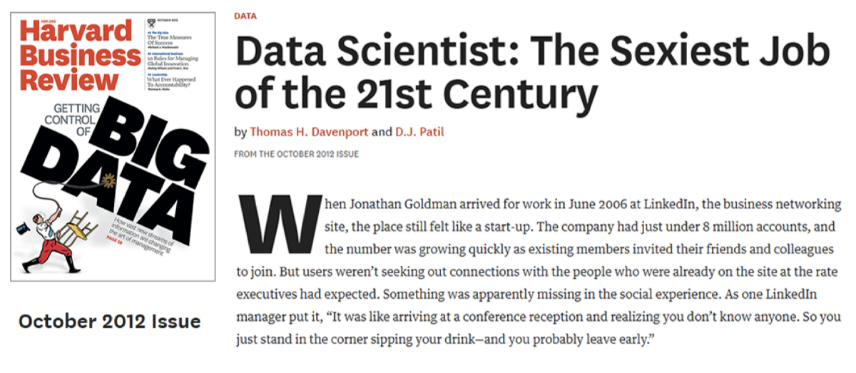
JOB RECOMMENDER VIA NATURAL LANGUAGE PROCESSING

Slide 2
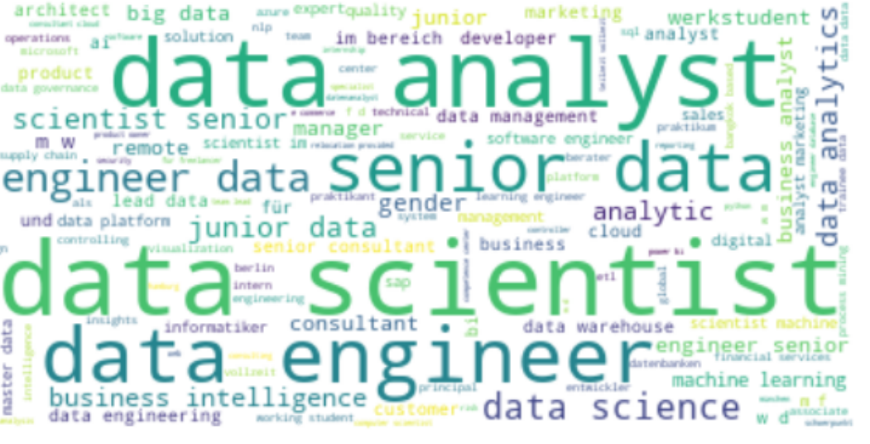



1. Web Scrapping
Time : 21.07 and 29.07
Keyword : Data scientist, Data Analyst, Data
Place : Germany
Platform : Indeed, Glassdoor and Linkedin
8182
3512
1310
Data Analyst
1303
Data Scientist
897
Data Engineer
Other

Slide 3
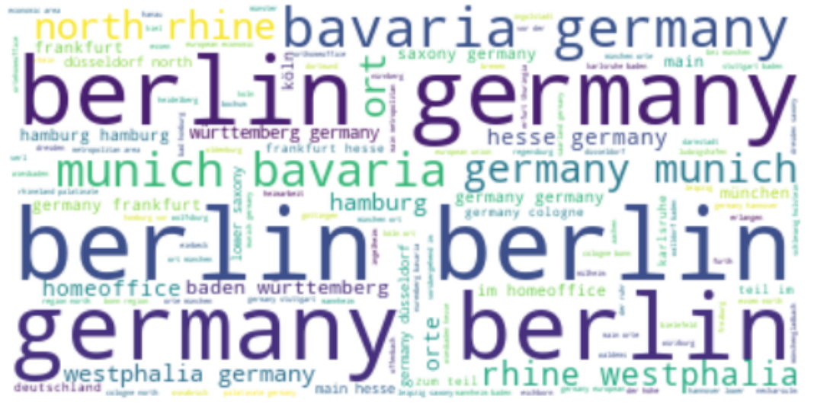
2. Exploratory Data Analyst
Language:
English: 1465
Geman: 2047
Location:
1. Berlin
2. Munich
3. Hamburg
4. Homeoffice
5. Frankfurt, Stuttgart, Düsseldorf

Slide 4
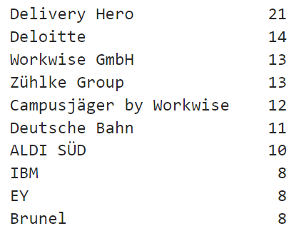
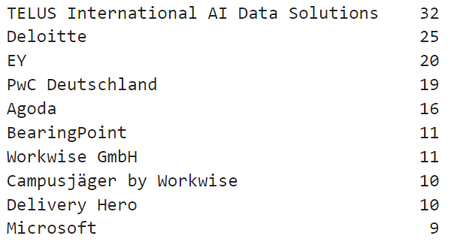
2. Exploratory Data Analyst
Company
Data scientist
Data analyst

Slide 5
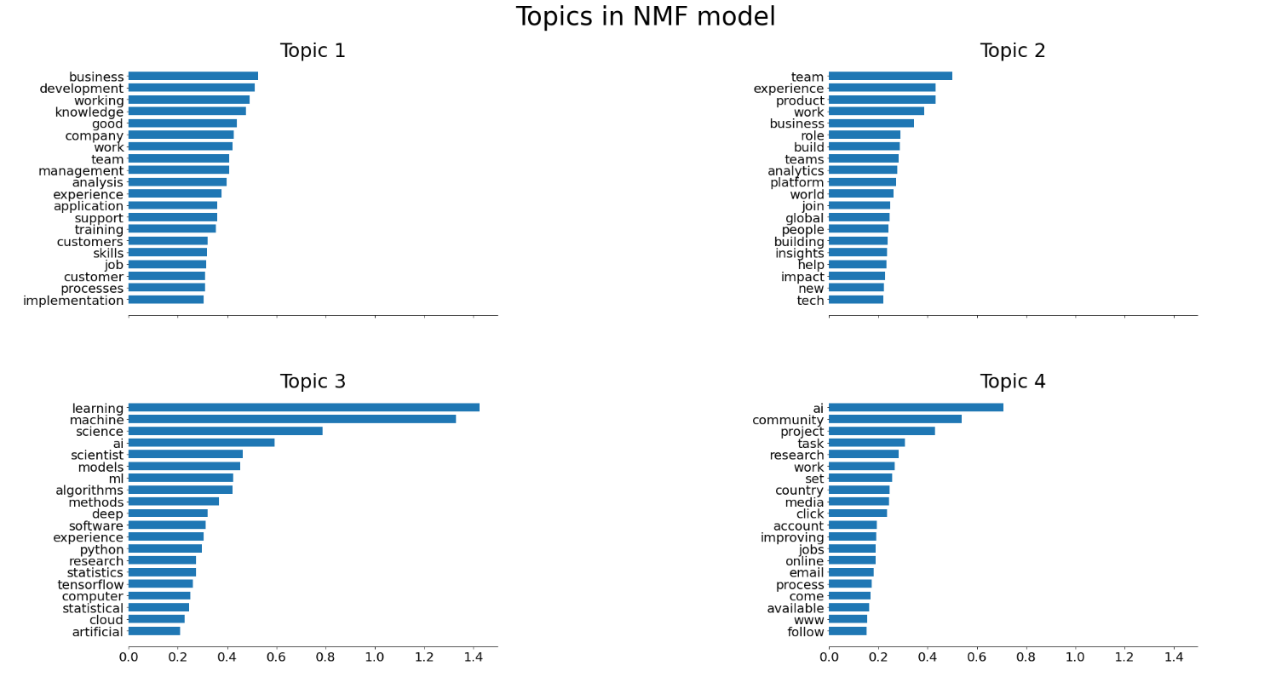
2. Exploratory Data Analyst

Slide 6
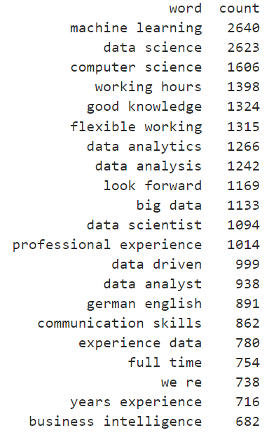
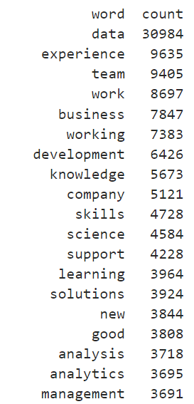
2. Exploratory Data Analyst
Two words
One word

Slide 7
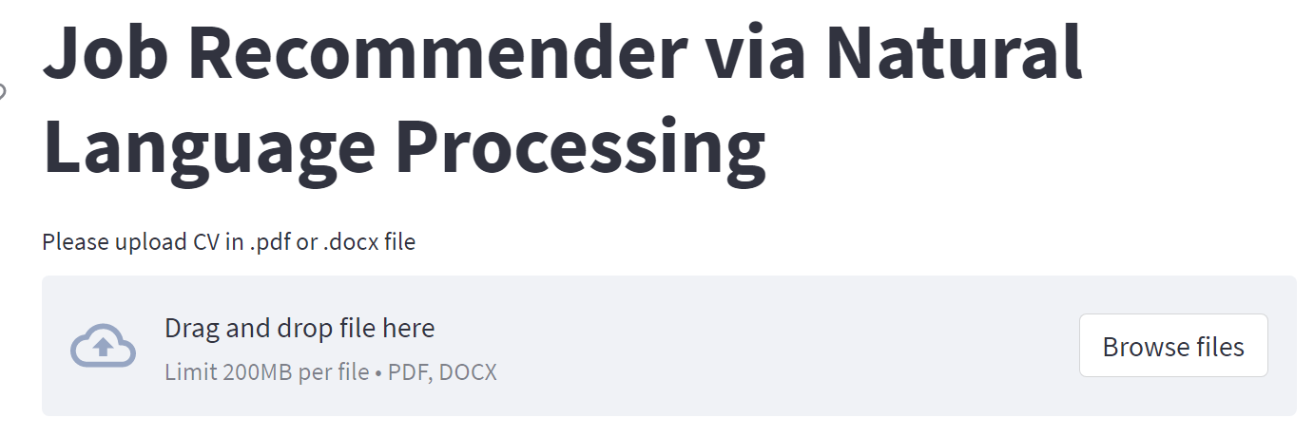
3. Job recommender
Using natural language processing (nltk, spacy)
Content Base recommender system
Cosin Similarity
Person correlation
KNN
Spacy similarity

Slide 8
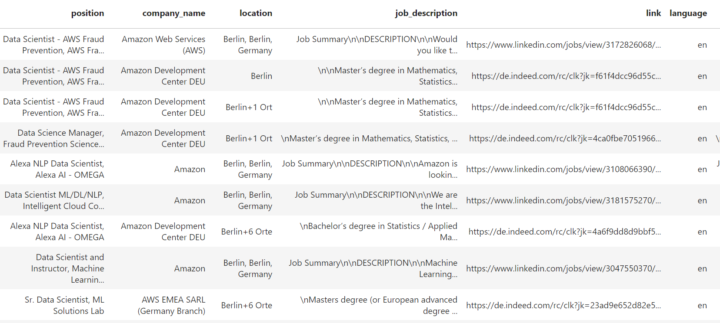
3. Job recommender
Evaluation

